Slide 1
CSCE 5300 INTRODUCTION TO BIG DATA AND DATA SCIENCE

Slide 2

Road Accident Severity Prediction and Classification using Machine Learning
Group 7:
Prathima Chowdary Sudalagunta
Prathyusha Jampala
Poojitha Pothini
Siva Manikanta Lakumarapu
Rakesh kumar Chekuri

Slide 3
INDEX
Abstract
Introduction
Requirements
Dataset
Data processing using pyspark
Data cleaning using pyspark
Exploratory Data Analysis
Vector Assembler creation
Splitting the data
Classification algorithms
Regression Algorithms

Slide 4
ABSTRACT
Road accidents are the most unfortunate thing to a road user,though they happen quite often.
Due to increasing number of traffic wrecks, it is necessary for us to able to predict the happening of an accident.
Road accidents can be reduced by accurate prediction based on the factors that cause road accidents.
The factors that mainly cause road accidents are unfavourable weather conditions,wet/damp roads,vehicle defects and human errors like overspeeding ,alcohol intoxication,etc.

Slide 5
ABSTRACT
Our project aims towards building the effective machine learning model for predicting the severity of accidents and to classify the severity based on the data gathered using one of the big data technologies pyspark.
Pyspark allows us to preprocess a large amount of data in real-time environment and helps in analysing the data interactively using python.

Slide 6
INTRODUCTION
Road accidents are the significant causes of mortality, hospitalization and disability.
The number of fatal road accidents are skyrocketing around the world,killing thousands of people and destroying property everyday without discrimination.
So,in order to find a solution for the problem, its is important to find out what factors are contributing to the accidents.
Accident severity analysis invloves three factors namely number of injuries,number of casualities and destruction of property.

Slide 7
INTRODUCTION
Severity of an accident is divided into four namely light injury,severe injury, fatal injury and property damage.
So our project includes determining the causes of the accidents and factors that cause the severity of the accident.
For this,the phases included are:
Cleaning of data using pySpark.
Seperating the data into training and test datasets.
Clustering features
Training automated classifiers
Testing each classifier individually

Slide 8
Requirements
Software-Anaconda-jupyter
Language-Python,Pyspark
Libraries-Pyspark,Matplotlib,Pandas

Slide 9
Work Flow Diagram:
Collecting the
data from RTA
dataset
Checking for
the null values
Converting the
catagorical data
into numerical one
Analysing the
data
Dividing the data
into train and test
Applying the
classification
models
Applying the
regression
models
Results

Slide 10
DATASET
The dataset we used for this project is Road Traffic accidents by Saurabh Shahane from kaggle and has 12000 rows and 32 columns.
Link for dataset:
https://www.kaggle.com/datasets/saurabhshahane/road-traffic-accidents?select=RTA+Dataset.csv

Slide 11
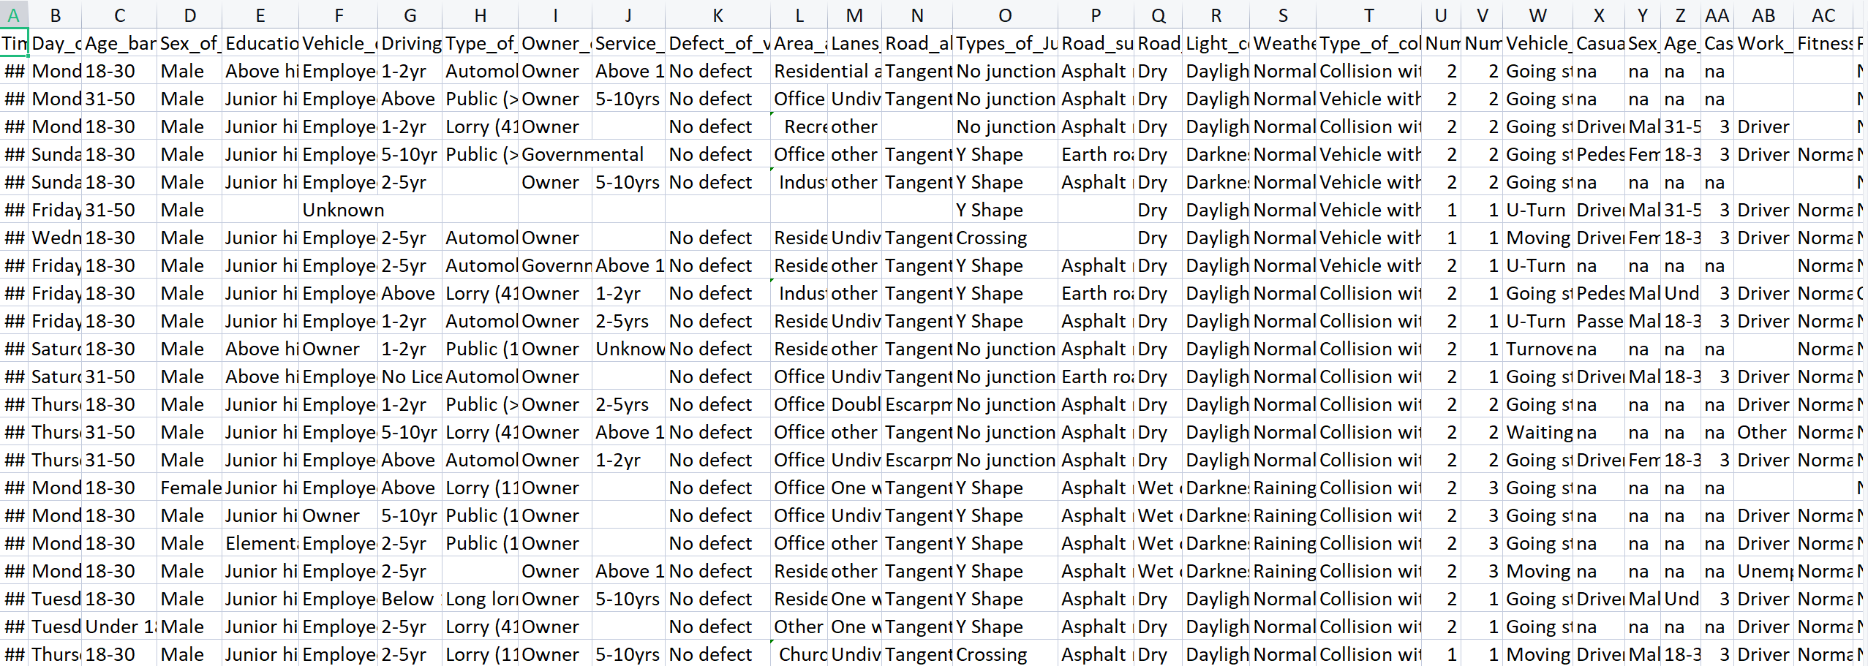
DATASET

Slide 12
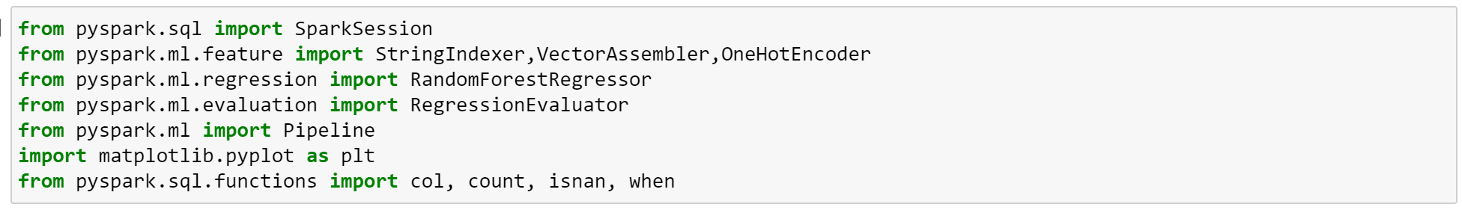
Data processing using pyspark
As our data has number of missing values,it is important to eliminate the noisy data and the missing data.
For this we imported the following libraries from pyspark to process the data and for applying the method required.

Slide 13
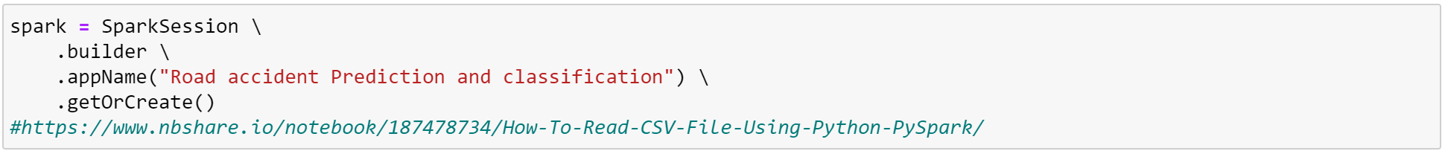
Data processing using pyspark
After that open the spark session[1] as below:
Read the dataset using spark[2] a shown below
Print the data as shown below:

Slide 14
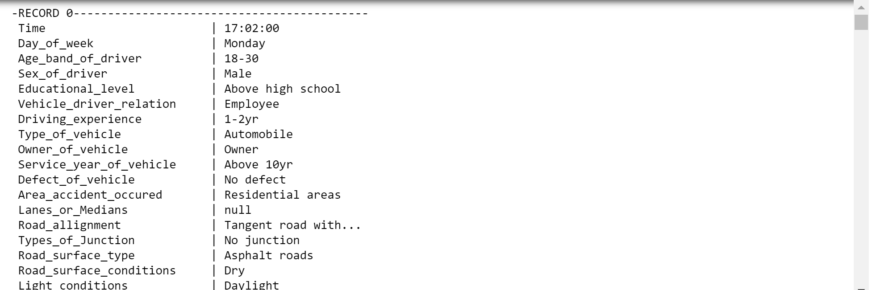
Data cleaning using pyspark
By displaying the data,the first 20 records of the dataset are shown as below:
It shows the records in a vertical format with name and value of attributes.

Slide 15
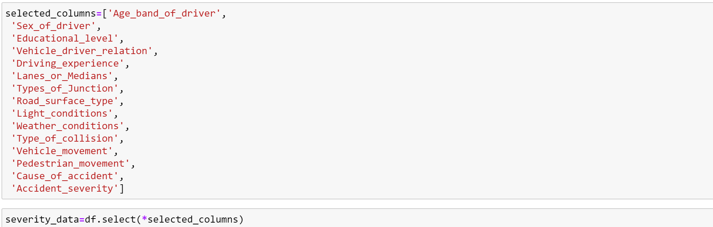
Data cleaning using pyspark
Now let us select the columns we needed for the project while removing the other columns from the dataset and store the data in new variable severity_data:
Now,let us recreate the dataset with only selected columns:

Slide 16
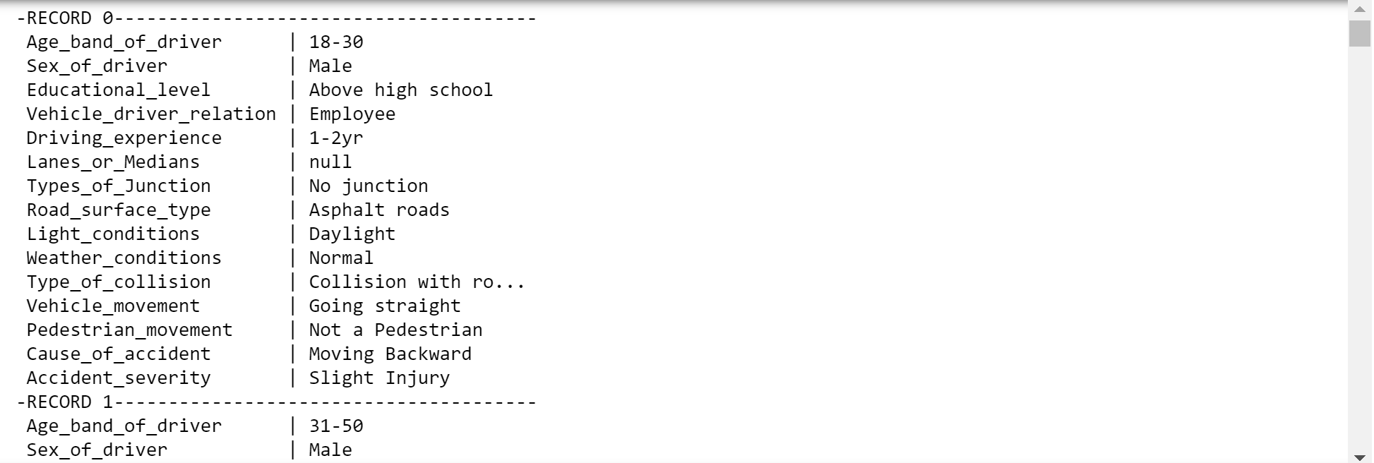
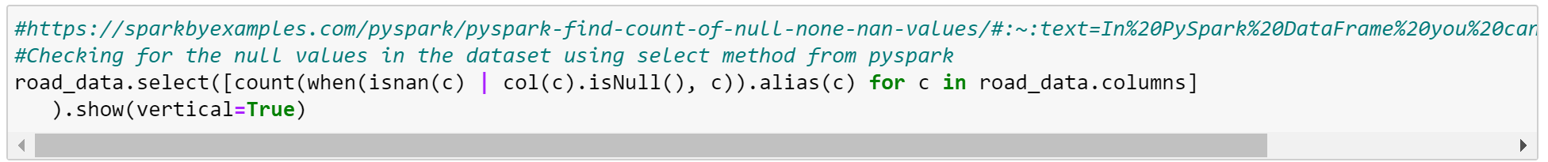
Data cleaning using pyspark
After creating the dataset with selected columns the dataset is a shown below:
Now,let us check the recreated dataset for null values[3]:

Slide 17
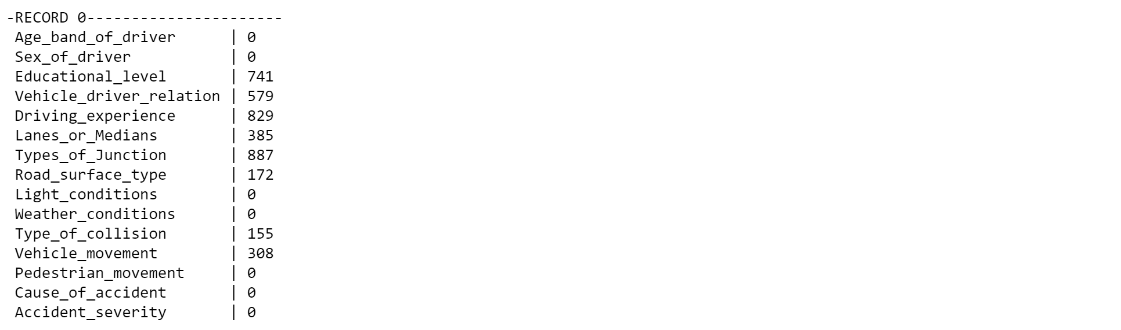
Data cleaning using pyspark
The below image depicts the columns with missing data and its number of missing values .
Now remove the null values using dropna()[4] method:

Slide 18
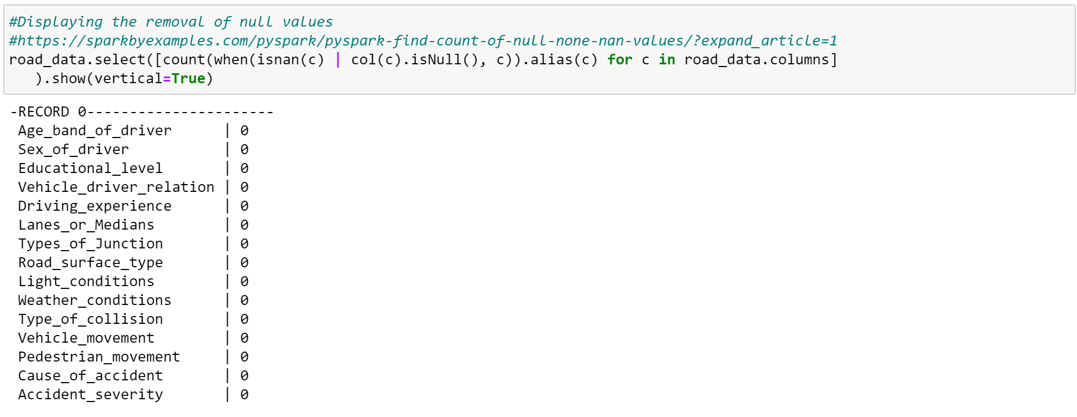
Data cleaning using pyspark
After dropping null values from the data[5] let us print the data to check again:

Slide 19
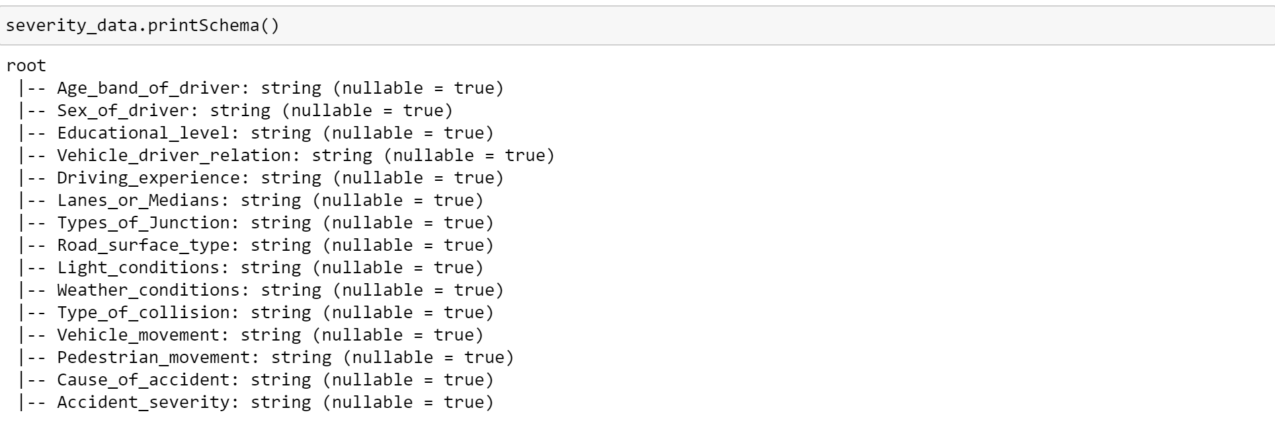
Data cleaning using pyspark
Now,if we print the schema of severity_data we can see that every value is a string.
Now,let us convert the categorical columns into numerical columns by applying StringIndexer() method of pyspark.

Slide 20
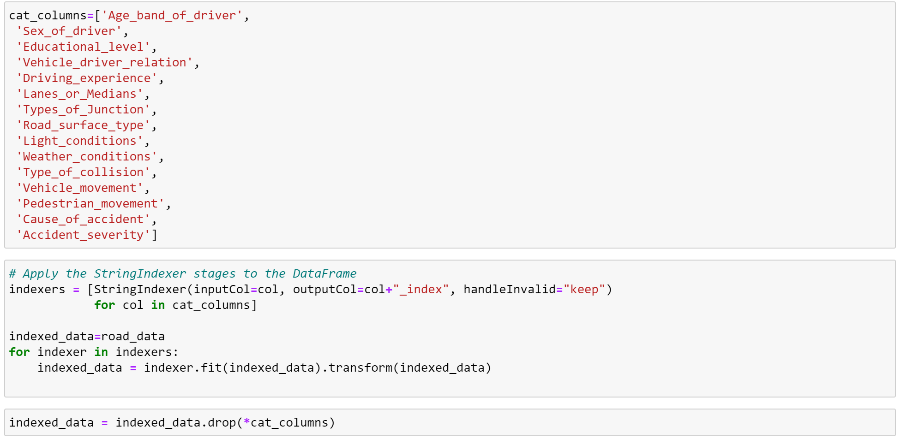
Data cleaning using pyspark

Slide 21
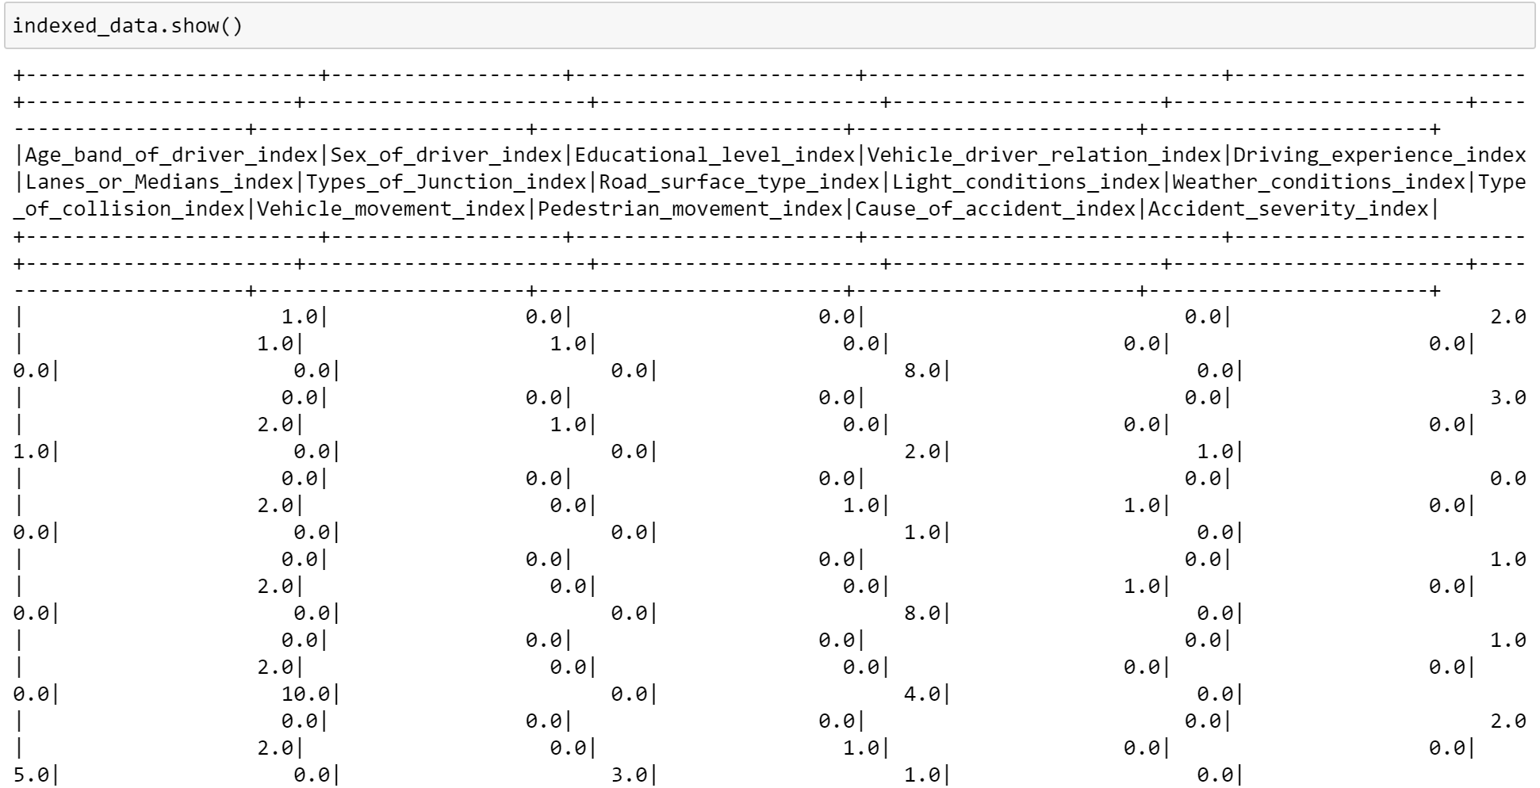
Data Cleaning using pyspark
After converting categorical values of data into numerical values,the data is as shown below:

Slide 22
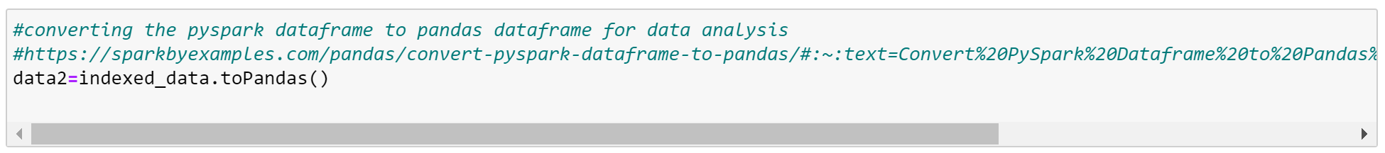
Exploratory Data Analysis
After data cleaning,let us convert the pyspark dataframe into pandas dataframe[6] for data analysis.
Let us display the correlation between features in the dataset.

Slide 23
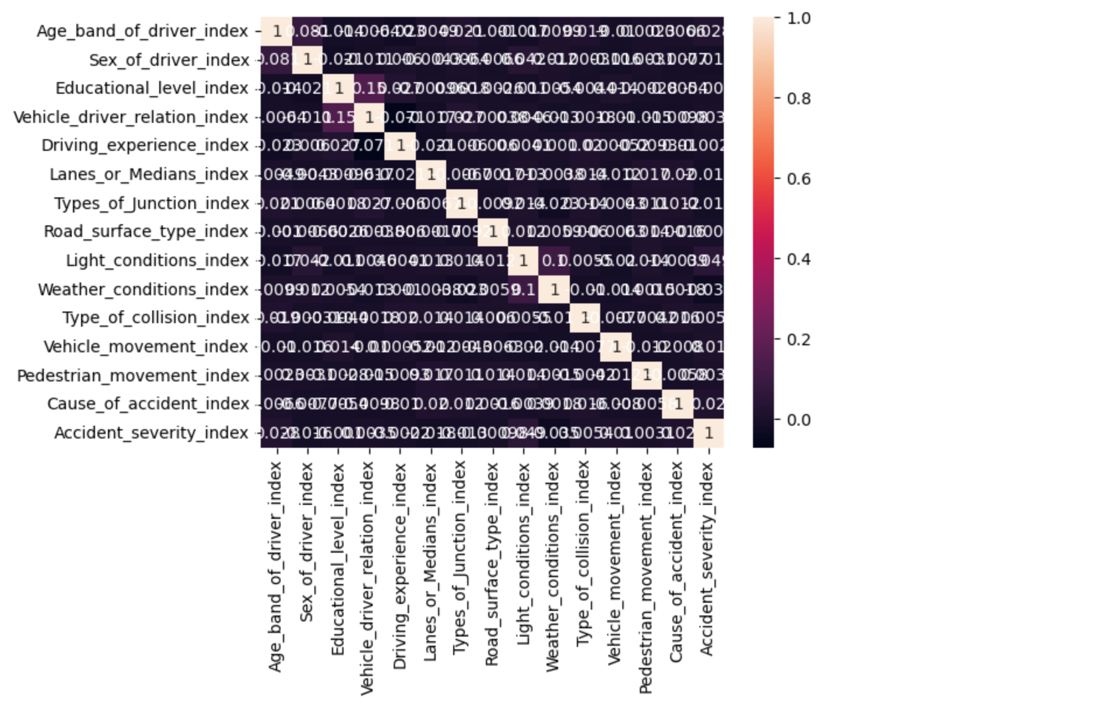
Exploratory Data Analysis

Slide 24
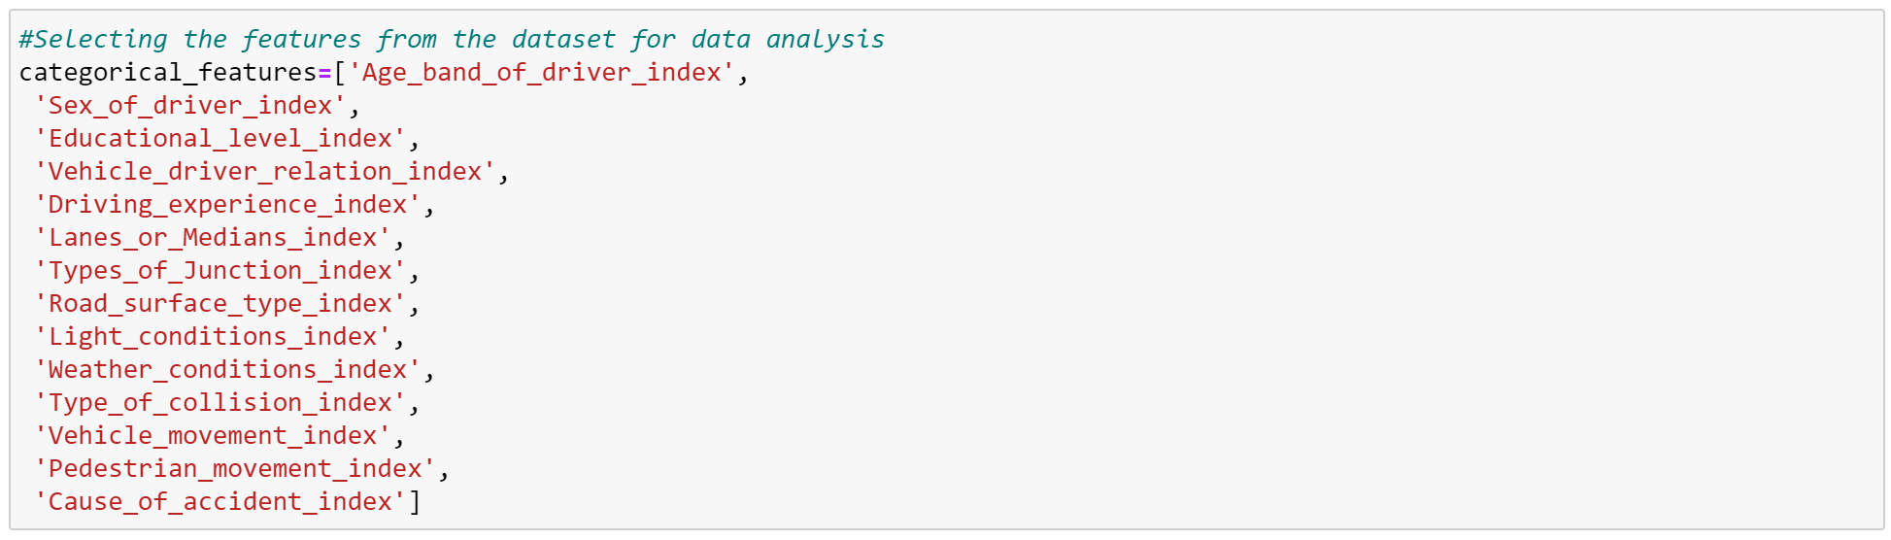
Exploratory data Analysis
Let us select the categorical features from dataset for data analysis:
After selecting categorical features,display the counterplot for the features selected in the dataset with help of ‘seaborn’ library of pandas.

Slide 25
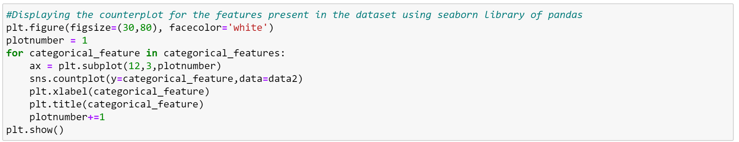
Exploratory Data Analysis
The code for displaying counterplot for categorical features is as below:

Slide 26
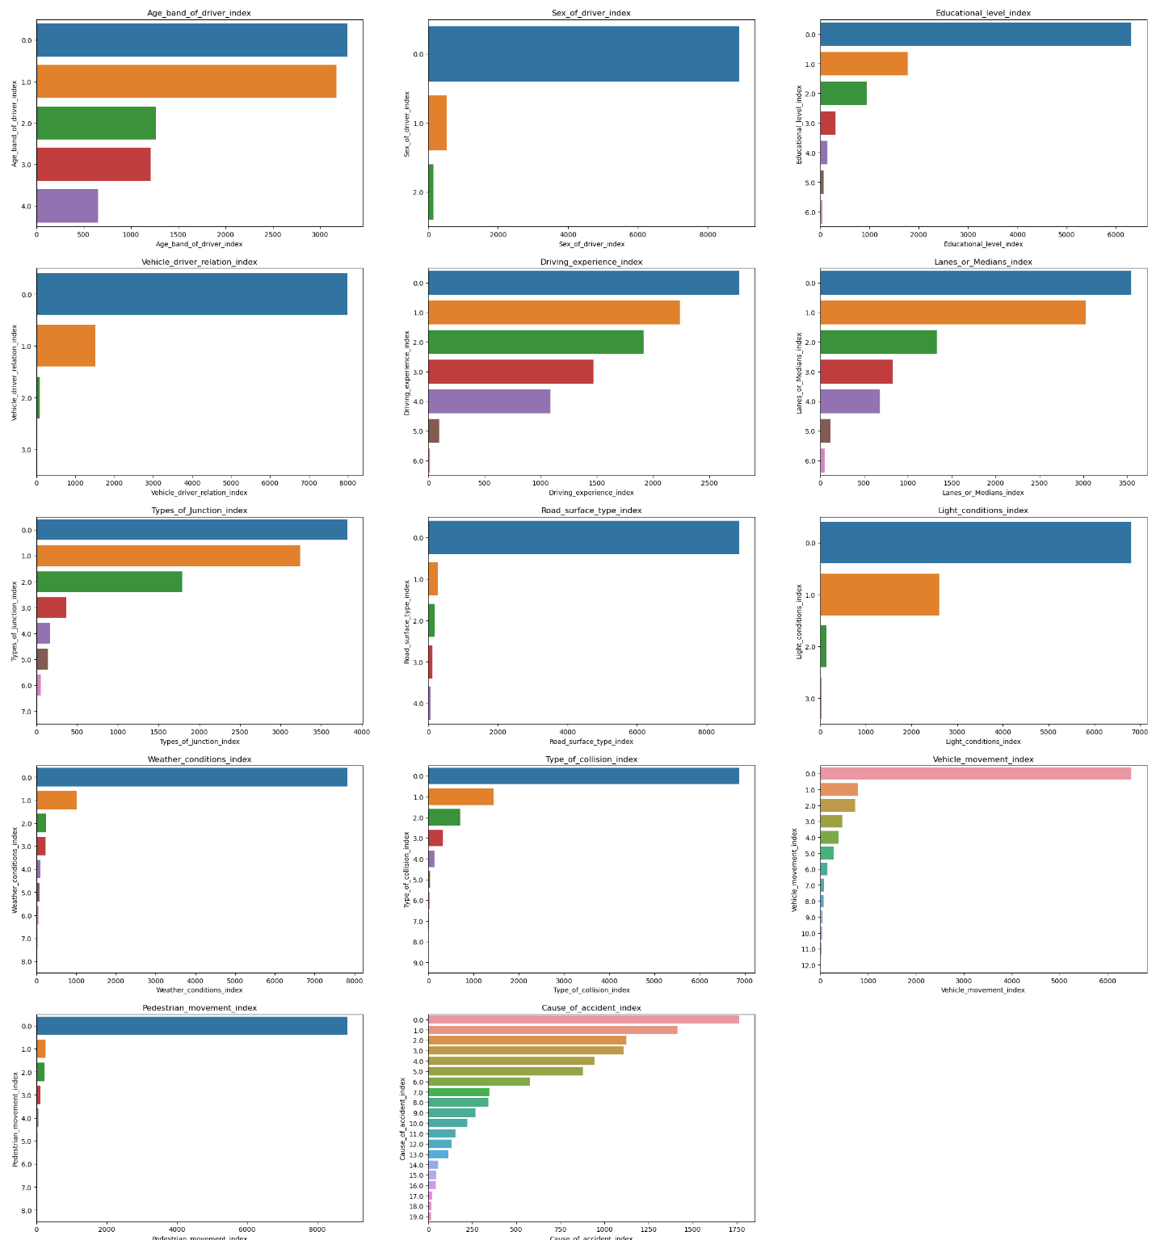
Exploratory Data Analysis

Slide 27
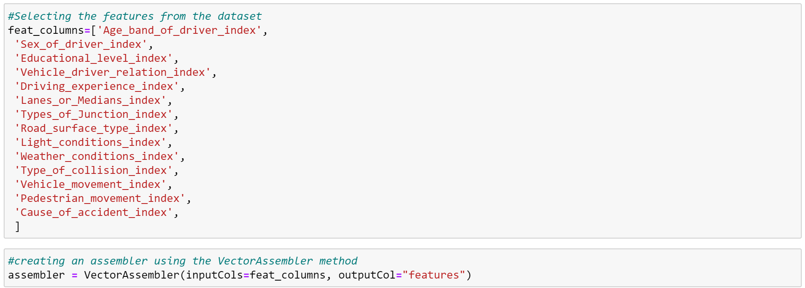
Creating the Vector Assembler
Select the features from the dataset and create an assembler for those selected features using VectorAssembler method.

Slide 28
Splitting the Data
Let us divide the data into training and testing dataset with 80% of data as training data and 20% of data as testing data.
Now let us use assembler to transform the training and testing data as sown below:

Slide 29
Classification Algorithms
In our project, as our data is quite large,we performed the following classifiers:
Random Forest Classifier
Logistic regression
Decision Tree classifier

Slide 30
Random Forest Classifier
It is a superivsed machine learning algorithm made up of several random decision trees which work on multiple subsets of the given dataset and provides the prediction accuracy based on the majority votes of predictions from the decision trees.
Higher the presence of decision trees present in the model, greater accuracy and prevents the problem of overfitting.
Ensemble learning is the method which combines multiple classifiers and enhance the performance of the model.
As our data is large and includes multiple classes,it one of the best machine learning algorithm for multi - class classification.

Slide 31
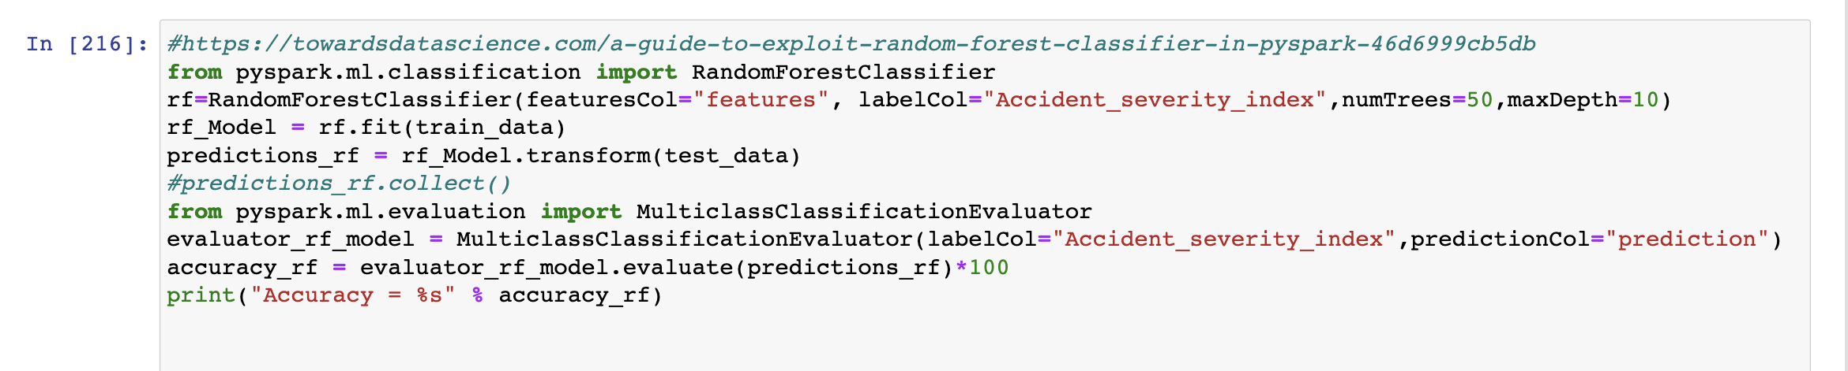
Random Forest Implementation[8]

Slide 32
Logistic Regression
It is also one of the classification method which is used to predict the value of one feature depending on the other.
It is used to find the relationship between two data features using mathematics.
There are multiple types of the models in logistic regression like binary,multinomial and ordinal.This multinomial method is used to predict the probability of the dependent variable which has more than possible outcomes.
As our data contains more than two classes we have used the multinomial method for our classification.
It also is one of the powerful tools in making the decisions among the classification algorithms.

Slide 33
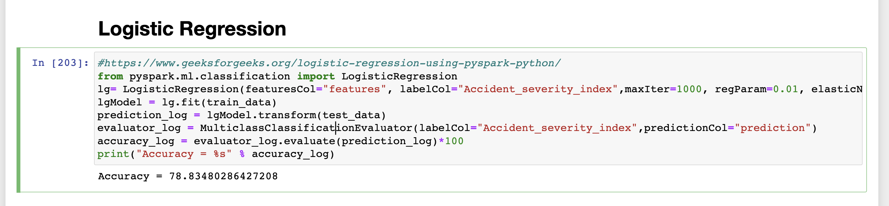
Logistic Regression Implementation[9]

Slide 34
Decision Tree classifier
Decision Tree is also a supervised learning which has some of set of rules to make decision, based on the decisions ,the model will predict the output.
It is a tree like heirarchical structure contains internal nodes for features in the dataset and branches represent the decision rules, leaf nodes for representing output.
It is the best systematic approach of classification algorithms of machine learning for classifying the dataset having multiple classes by asking a set opf questions to features of the given dataset.

Slide 35
Decision Tree classifier
Moreover, decision tree does not take much efforts for preprocessing of data and provides accurate results of the inner works like making decisions etc.
Moreover,this algorithm is the best when we handling with the large datasets because it will not stop the speed of prediction and does not effect the efficiency of the accuracy.

Slide 36
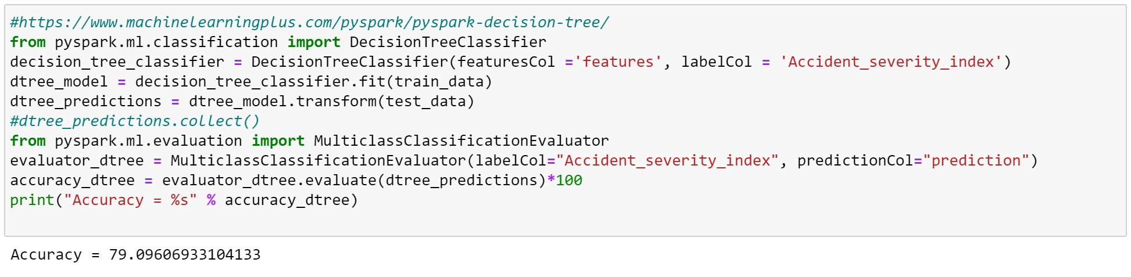
Decision Tree implementation[10]

Slide 37
Results
As we can see from the results, we observe that Random forest and Logistic regression models almost provides the same accuracy but the decision tree classsifier shows some what highest accuracy of 79.02 among the others.
Classification Model | Accuracy
Random Forest Classifier | 78.93
Logistic Regression(multinomial) | 78.83
Decision tree Classifier | 79.02

Slide 38
Regression Algorithms
Regression is a supervised machine learning which is used to map data points to labels.In our project we used the following regression algorithms:
Random Forest Regressor
Decision Tree Regressor

Slide 39
Random Forest Regressor
It is a superivsed machine learning algorithm which is also referred as bagging method that works on ensemble learning for regression.
The random forest regressor algorithm works to predict the continuous data.So we have converted the categorical data in our dataset into numerical one for the prediction.
In this method,the decision trees protect each other from their individual errors.
As our data has high dimemsionality,we used random forest regressor as it is great with high dimensionality.

Slide 40
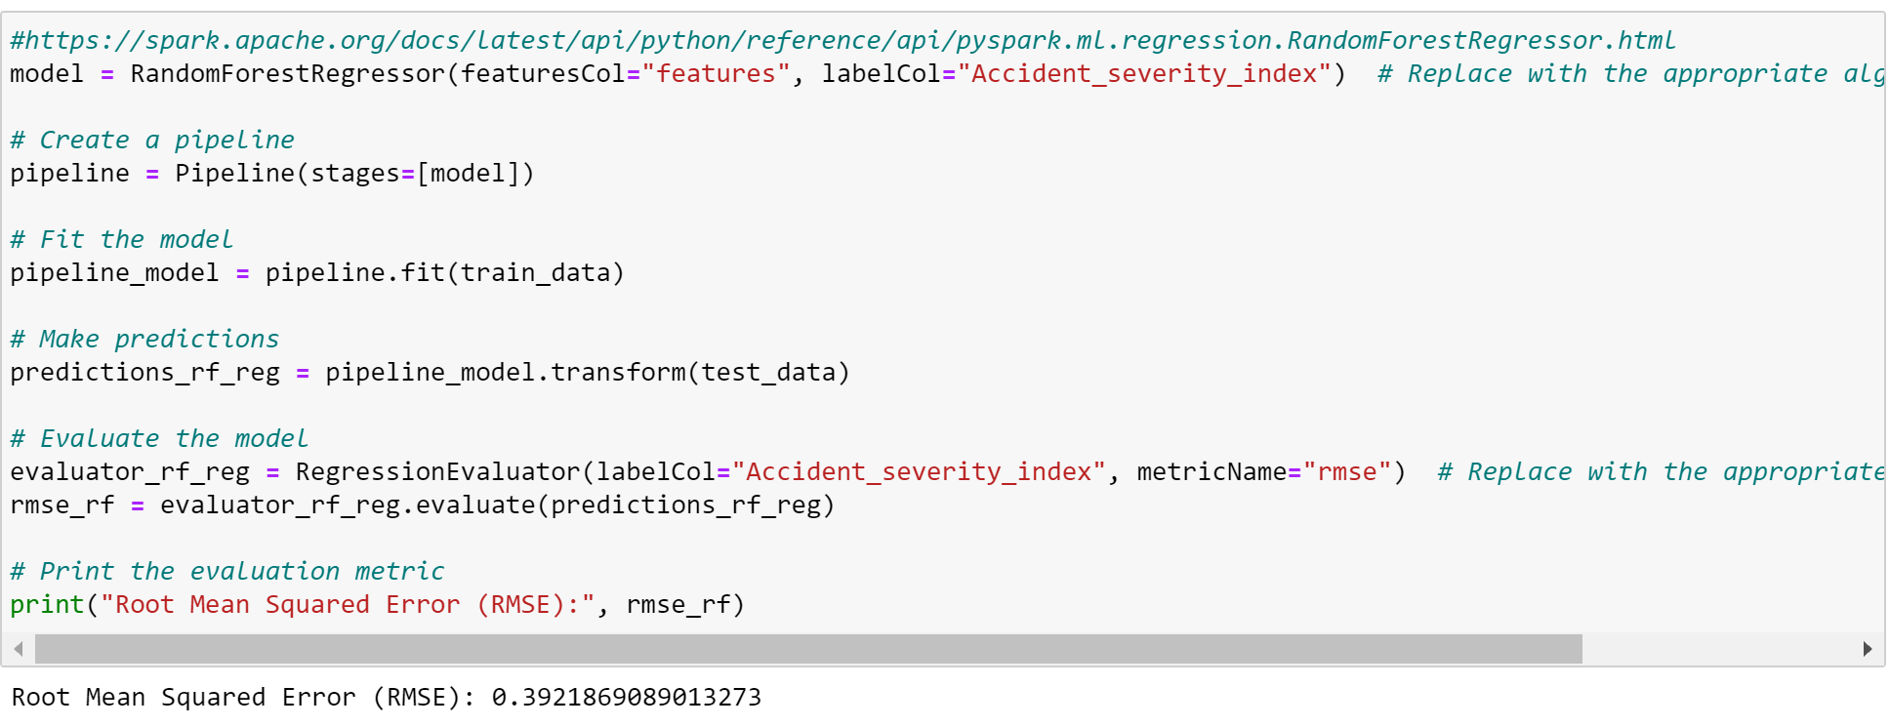
Random Forest Implementation[11]

Slide 41
Decision Tree Regressor
Decision Tree regressor is one of the predictive models which are uses the set of binary rules for computing the target value.
It also works on the same principle (using decision rules)that is mentioned in classifier but for the numerical or the continuous data.
It observes the features of an object and trains the model in the form of a tree and predicts data in the future.
We used decisison tree regressor to predict happening of the type of accident.

Slide 42
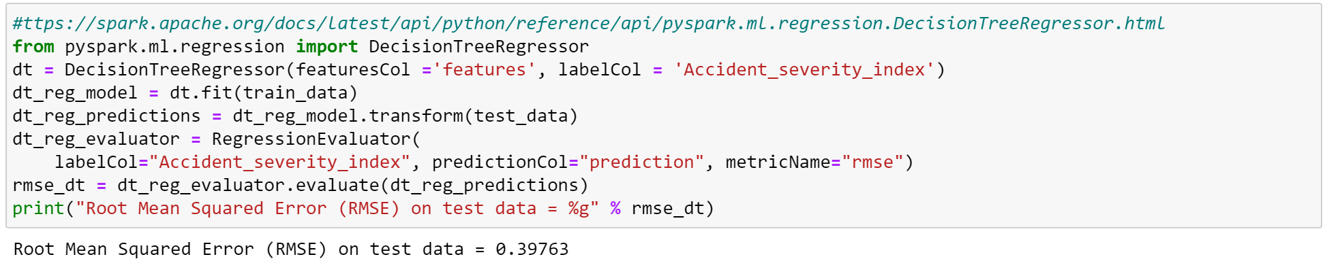
Decisison Tree Implementation[12]

Slide 43
Results
As we can see from the above algorithms, we observe that Random forest and Decisison Tree has almost same Root Mean Squared Error but the RandomForest has less Root Mean Squared Error than Decision Tree regressor.
Regression Model | Root Mean Square Error
Random Forest Regressor | 0.3921869089013273
Decisison Tree Regressor | 0.39763

Slide 44
References
https://ieeexplore.ieee.org/document/9972671(Road Accident Prediction and Classification using Machine Learning)
https://ieeexplore.ieee.org/document/8843640(Road Accident Analysis and Prediction of Accident Severity by Using Machine Learning in Bangladesh)
https://ieeexplore.ieee.org/document/9596664(Prediction of Traffic Accidents Severity Based on Machine Learning and Multiclass Classification Model)
https://ieeexplore.ieee.org/document/8907230(Implementation of Data Preprocessing Techniques on Distributed Big Data Platforms)

Slide 45
Future Scope:
We can further build the web app for this , so that it enhances the user experience for using this project.
We will also try to use the other machine learning algorithms or try to implement the efficient methods to increase the accuracy of the model.

Slide 46
References
https://ieeexplore.ieee.org/document/9092388(An efficient and scalable SPARK preprocessing methodology for Genome Wide Association Studies)
https://www.analyticsvidhya.com/blog/2022/04/data-preprocessing-using-pysparks-dataframe/

Slide 47
Citations
[1]https://www.nbshare.io/notebook/187478734/How-To-Read-CSV-File-Using-Python-PySpark/
[2]https://www.nbshare.io/notebook/187478734/How-To-Read-CSV-File-Using-Python-PySpark/
[3]https://sparkbyexamples.com/pyspark/pyspark-find-count-of-null-none-nan-values/#:~:text=In%20PySpark%20DataFrame%20you%20 can, count()%20and%20when().
[4]https://sparkbyexamples.com/pyspark/pyspark-drop-rows-with-null-values/#:~:text=By%20using%20the%20drop(),result %20in%20 NULL%20on%20DataFrame

Slide 48
Citations
[6]https://sparkbyexamples.com/pyspark/pyspark-find-count-of-null-none-nan-values/?expand_article=1
[7]https://sparkbyexamples.com/pandas/convert-pyspark-dataframe-to-pandas/#:~:text=Convert%20PySpark%20Dataframe%20to %20Pandas% 20DataFrame,small%20subset%20of%20the%20data.
[8]https://towardsdatascience.com/a-guide-to-exploit-random-forest-classifier-in-pyspark-46d6999cb5db
[9]https://www.geeksforgeeks.org/logistic-regression-using-pyspark-python/

Slide 49
Citations
[10]https://www.machinelearningplus.com/pyspark/pyspark-decision-tree/
[11]https://spark.apache.org/docs/latest/api/python/reference/api/pyspark.ml.regression.RandomForestRegressor.html
[12]https://spark.apache.org/docs/latest/api/python/reference/api/pyspark.ml.regression.DecisionTreeRegressor.html

Slide 50
THANK YOU

